Slide 1
Telecom Customer Churn & Revenue Risk Analysis
Business Intelligence & Customer Retention Strategy
By Mawadda Hassan
Tools Used:
SQL, Power BI, Excel

Slide 2
Business Problem
Customer churn directly impacts recurring revenue and long-term profitability. The company observed significant customer attrition and required an analysis to:
Understand churn behavior
Identify high-risk customer segments
Quantify revenue impact
Recommend retention strategies

Slide 3
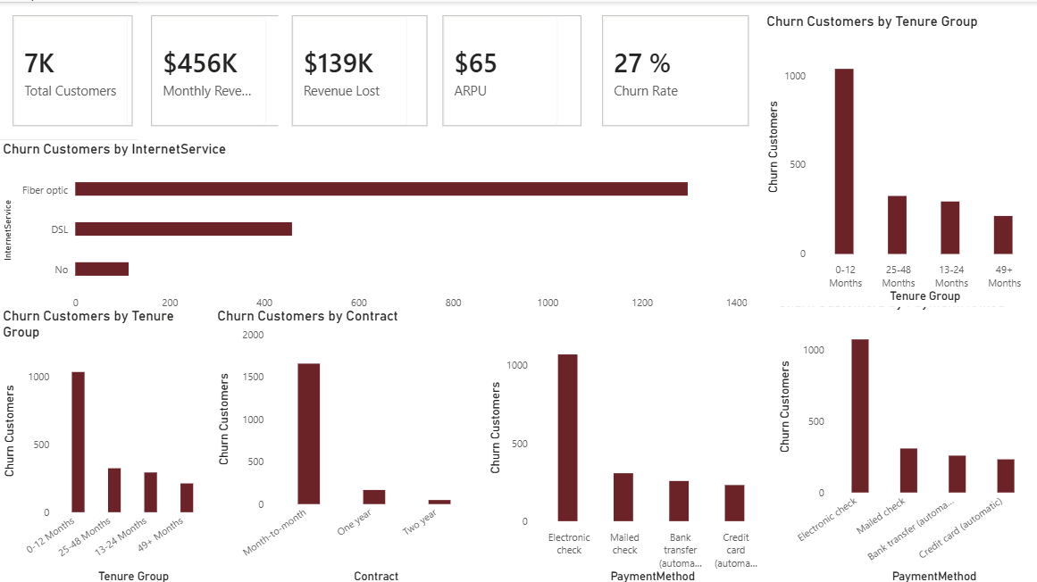

Slide 4
Project Objectives
The project aimed to answer five key questions:
What is the overall churn rate?
Which customer groups churn most frequently?
Which services are associated with churn?
How much revenue is at risk?
What actions can reduce churn?

Slide 5
Methodology
Data Collection
↓
Data Cleaning
↓
SQL Analysis
↓
KPI Development
↓
Power BI Dashboard
↓
Business Recommendations
Dataset: IBM Telco Customer Churn Techniques:• Data Cleaning• Customer Segmentation• KPI Analysis• Revenue Impact Assessment

Slide 6
Key Findings
Overall churn rate: 26.5%
Month-to-month customers exhibited the highest churn rates.
Most churn occurred within the first 12 months of service.
Electronic check customers churned more frequently than other payment groups.
Fiber optic customers showed elevated churn levels.

Slide 7
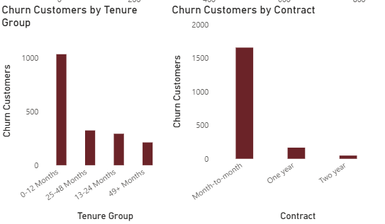

Slide 8
Revenue Impact
Revenue Lost from Churn:
$139K
Monthly Revenue:
$456K
Percentage of Revenue at Risk:
30.5%

Slide 9
Recommendations
1. Increase adoption of long-term contracts.
Reason:
Month-to-month customers showed the highest churn levels.
2. Improve onboarding during the first year.
Reason:
Most churn occurs within the first 12 months.
3. Investigate electronic check user experience.
Reason:
This segment exhibited elevated churn.
4. Conduct service quality reviews for fiber optic customers.
Reason:
Higher churn was observed in this group.

Slide 10
Business Value
This analysis identified key churn drivers, quantified revenue risk, and provided actionable recommendations to improve customer retention. Expected Benefits:
• Reduced customer attrition
• Increased revenue retention
• Improved customer satisfaction
• Better targeting of retention campaigns

